Slide 1


Slide 2

#LifeKoKaroLift
SGC Coaching:
Session 9
Track Guidance

Slide 3
Agenda: Career Recommendation
Quick Overview –(10 mins)
DS Tracks and expected career outcomes
Personalized Discussion –(80 mins)
In-depth discussion and recommendation for Career tracks
Provide personalized feedback

Slide 4
Overview of Career Tracks: Professional Roles and Tech Know-How
Data Engineering
Data Analyst (BI)
Business Analyst
Deep Learner
NLP
Notes:
Remind the learners of the tracks and their relevance.

Slide 5
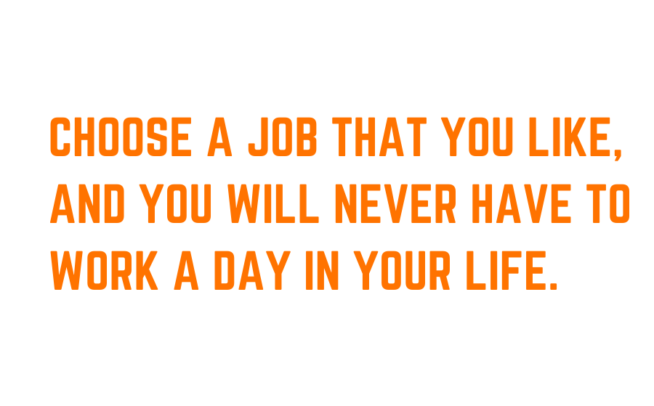
Career

Slide 6






iKigai
Good At
Passion
Profession
You Love
Paid For
Mission
World Need
Vocation
Notes:
Some cases in the next slides
Examples:
Career outcome related uncertainty ( How will the chosen track enable my career goal?)
How to carve opportunity in the chosen track? (In case of acceleration)

Slide 7
What To Focus On For Respective Tracks?
DE
DA
BA
NLP
DL
Tools
Techniques
Solutions
Big Data Tools
Cloud Technologies
RDBMS & No-SQL tools
Tableau/ Power-BI/Qlikview
Python
Tensorflow
Distributed computing system/ Workflow Management
ML Supervised/ Unsupervised
Time-series Analysis
Topical Modelling
Computer vision
Sentiment Analytics
Recommendation Engine
Growth drivers
Assortment Optimization
Fraud Analytics
Churn Analytics
While each career track has to be proficient with certain tools (e.g. Python), each career track has their own focus areas as mentioned above.
Notes:
Recap on the tools, techniques and solutions relevant to every specializations and the common ones to excel in the respective profiles.
It can also be in conjunction with their experience with different skills so far and the gap to be bridged in order to create differential skills.

Slide 8


Is Your Choice In Line With Expected Outcomes?
Questions to ponder on:
Will the track create a differential element in your profile?
Does this fall in line with your previous work experience or do you want to venture into something new?
Do your target organisations or companies in general hire people with similar work experience as yours?
Does the track fall in line with your interests?

Slide 9
Personalized Discussion
Have you decided your career Track?
Yes, very clear.
Almost, need a few inputs
Undecided
Aspiration vs. Reality
Aspiration: Preferred critical role in organization
Current performance: your sweet spot vs. limitation within course/ on the job
Feedback on Fitment
Profile suitability
Skill- set related fitment
Soft skills/ Competencies
Coach feedback
N
Y(1)
Which factors have you considered for this choice?
How is the choice going to add differential advantage towards your outcome?
Refer the rule engine to confirm
Decide with AI: Rule Engine for Career Track
Things to remember:
Career tracks are not carved in stone and you get a chance for mobility
The tracks are inter-correlated in certain aspects so you can graduate towards your goal despite current lack of skillsets.
Notes:
Y is the first option, N are the other two. Those who need specific inputs to finalize, can also be guided directly to rule engine.
You must let learners take the lead during the conversation.
Profile Suitability will depend on the career outcome
Profile Suitability will depend on the career outcome
In terms of feedback, also discuss potential opportunities for them where they can leverage the learning.
Skill set must include depth and breadth of capabilities (Tools, techniques, solutions)

Slide 10
Rubric based decision approach (ET/NET)
Group Persona Category | Background | Work Ex. |  | CTC ( LPA ) | Track Recommendation
ET (Experienced-Tech) | Technical | High (> 8) | 8-12 | 8-12 | DE/DL/NLP
 |  |  |  | 12-15 | DE/DL/NLP
 |  |  |  | 15-20 | BA/DE/DL/NLP
 |  |  |  | 20+ | BA/DE/DL/NLP
 |  |  | 12+ | 12-15 | BA/DE/DL/NLP
 |  |  |  | 15-20 | BA/DE/DL/NLP
 |  |  |  | 20-30 | BA
 |  |  |  | 30+ | BA
NET (Non-Experienced-Tech) | Technical | Low (< 8) | 0-3 | <5 | DA/DE
 |  |  |  | 5-8 | DA/DE
 |  |  |  | 8-12 | DA/DE/DL/NLP
 |  |  |  | 12+ | DA/DE/DL/NLP
 |  |  | 3-5 | <5 | DA
 |  |  |  | 5-8 | DA
 |  |  |  | 8-12 | DA/DE/DL/NLP
 |  |  |  | 12+ | DA/DE/DL/NLP
 |  |  | 5-8 | 5-8 | DA/DE/DL/NLP
 |  |  |  | 8-12 | DA/DE/DL/NLP
 |  |  |  | 12-15 | DE/DL/NLP
 |  |  |  | 15+ | DE/DL/NLP

Slide 11
Rubric based decision approach (ENT/ NENT)
Group Persona Category | Background | Work Ex. |  | CTC ( LPA ) | Track Recommendation
ENT (Experienced-Non-Tech) | Non-Technical | High (> 8) | 8-12 | 8-12 | BA/DA
 |  |  |  | 12-15 | BA
 |  |  |  | 15-20 | BA
 |  |  |  | 20+ | BA
 |  |  | 12+ | 12-15 | BA/DA
 |  |  |  | 15-20 | BA
 |  |  |  | 20-30 | BA
 |  |  |  | 30+ | BA
NENT (Non-Experienced-Non-Tech) | Non-Technical | Low (< 8) | 0-3 | <5 | DA/BA/DE
 |  |  |  | 5-8 | DA/BA/DE
 |  |  |  | 8-12 | DA/BA
 |  |  |  | 12+ | DA/BA
 |  |  | 3-5 | <5 | BA/DA
 |  |  |  | 5-8 | BA/DA
 |  |  |  | 8-12 | BA/DA
 |  |  |  | 12+ | BA/DA
 |  |  | 5-8 | 5-8 | BA/DA
 |  |  |  | 8-12 | BA/DA
 |  |  |  | 12-15 | BA/DA
 |  |  |  | 15+ | BA

Slide 12
Case Scenarios
Types of Cases
Confusion in 2-3 tracks
No opportunity to go for particular role
Skills similar to track A but want to choose B
No Professional experience/ No relevant experience
Academics/ Defence
No domain context
Not clear between DA/ BA
Expected growth/ role
Technical skills matching
Aspiration vs. Reality
Aspiration: Deep Learning track
Reality: Never used coding in real life but conceptual understanding of ML techniques is good.
Reality Check
Deep Learning track will not be feasible with current skills.
Performance on coding assignments: Took more time
Recommendation
BA track could be better since you will stay in touch with the modeling and interpretation of models
Notes:
Not to share with learners
Discuss how they can apply their learnings in real business context.
Those who have 5-6 years of experience, but not relevant, competency and feedback from the session learning will play key role to explain/ convince on the recommendation.
If one is more well versed in SQL, Python, or has worked on data and wants to build more learning on tools with basic analysis, DA track is preferable. If the domain context is high and has more opportunities to work across stakeholder for analysis, BA is better.

Slide 13

Questions?
Address the doubts related to:
Conflict in decisions
Rule Engine based choice
Individual help needed
Notes:
Some cases in the next slides
Examples:
Career outcome related uncertainty ( How will the chosen track enable my career goal?)
How to carve opportunity in the chosen track? (In case of acceleration)

